Slide 1

AUTOMATIC ROOM LIGHT CONTROLLER
TEAM MEMBERS:
BHUVANESH R(20BEC4022)
Guided by:
Dr.C.VIVEK

Slide 2
CONTENTS
Aim of the project
Introduction
Components Required
Block Diagram
Circuit Diagram
Working
Advantages and Limitations
Applications

Slide 3
AIM OF THE PROJECT
The aim of our project is to make a controller which can sense if any person enters the room and it lights up the room automatically and also counts how many person are entering the room or going out of it.
It is made to prevent unwanted electric power waste in schools, colleges, offices and houses.
This whole process is operated automatically by its sensors.

Slide 4
INTRODUCTION
In today's world, there is a continuous need for automatic appliances.
The objective of this project is to make a controller based model to count number of persons visiting particular room and accordingly light up the room automatically.
Here we are using sensor and controller to count the no.of persons in the room and display it on LCD.
If there is at least 1 person in the room, the LED will glow else it will remain off.

Slide 5
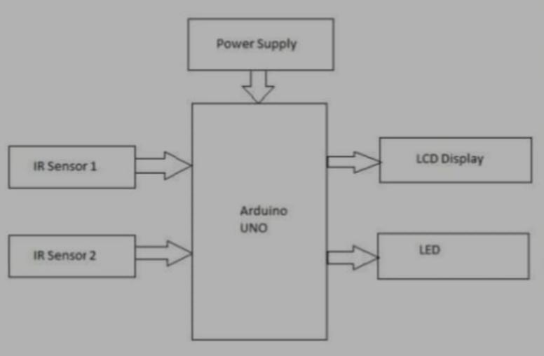
BLOCK DIAGRAM

Slide 6
COMPONENTS REQUIRED
Arduino UNO
Resisters
IR Sensor module
16x2 LCD display
Bread Board
Connecting Wires
LED
Audrino IDE

Slide 7
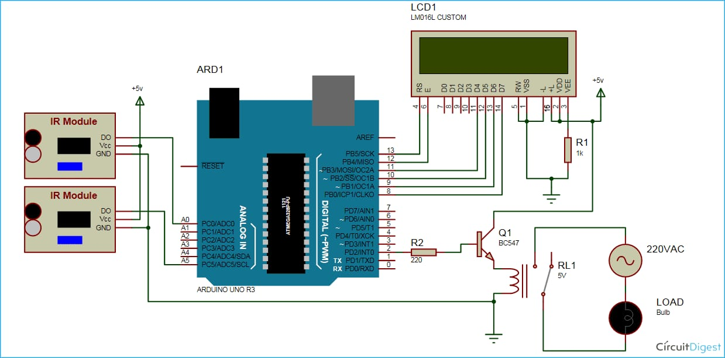
CIRCUIT DIAGRAM

Slide 8
WORKING
The IR sensor continuously senses the presence of any obstacles (a person in our case).
If sensor 1 senses a person, it informs the controller that a person has entered so that controller can increment the count. - At the same time it gives a delay of 1sec so that the person can cross the sensor 2 and the count is maintained correctly.
When a person exits, the sensor 2 informs the controller to decrement the count. Similarly it also provides a delay of 1 sec to maintain count properly.
The count is displayed on LCD by the controller.
If there is at least 1 person is inside the hall, an LED will glow otherwise it is off.

Slide 9
ADVANTAGES
Can be used for automatic room light control.
It will help to save electricity. When no one is there in room the appliances will be off.
In School/companies it will help to check if somebody is there in the zone or not. If the data on display unit is zero the security guards can shut the gate easily.

Slide 10
LIMITATIONS
It is used only when one person cuts the rays of the sensor hence cannot be used when two or more persons cross the door simultaneously.
When anybody is inside the room and we need to switch off the power then we've to do it manually. So, in this case we fail to automatically control the light.

Slide 11
APPLICATION
This circuit can be used domestically to get an indication of number of persons entering a party.
It can be used at homes and other places to keep a check on the number of persons entering a secured place.
It can also be used as home automation system to ensure energy saving by switching on the loads and fans only when needed.

Slide 12
THANK YOU

